Slide 1

Lecture – 10/6/2016
CSCI 36300 – Software Design

Slide 2
Assignment #2 – Questions?

Slide 3
Quiz #8

Slide 4
Assignment #3

Slide 5
Assignment #3
Case Study
Calculator
Due Date:
1st Phase Submission:
10/20/2016
Design Patterns:
Command Pattern
(Abstract) Factory Pattern

Slide 6
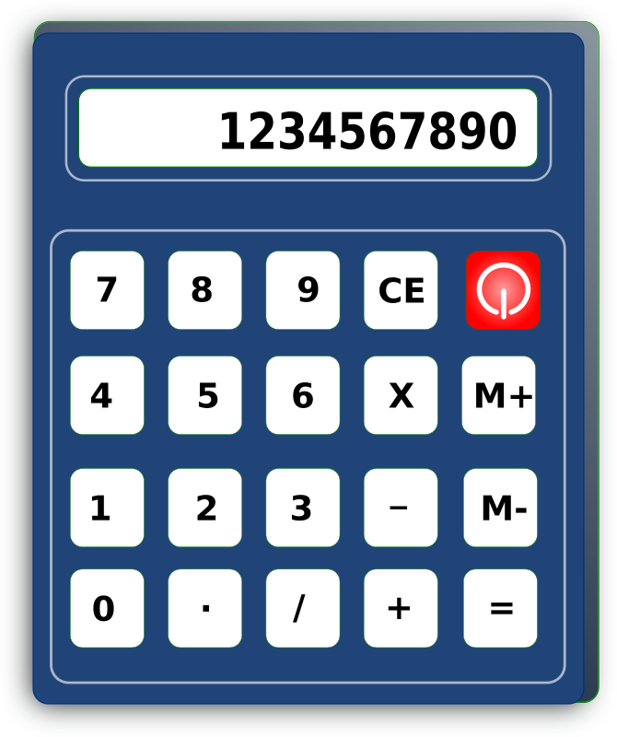
Case Study: Calculator
Develop an object-oriented basic calculator using C++.
Patterns & Principles
Goals:
Demonstrate how to apply design patterns to a concrete example
Compare/contrast different OO design approaches.

Slide 7
Case Study: Calculator
The calculator should provide the following basic functionality:
Mathematical Evaluation:
15 + 7
15 + 7 / 10
10 % 4
We want our calculator to be extendible for the following operations later on:
Square Root
Powers (Exponents)
Etc.

Slide 8
Case Study: Calculator
Expression Evaluation:
It is hard for a computer to evaluate an Infix-formatted expression:
15 + 10
Lets take a moment to break down the key components:
Operands:
1,2,3,4,5,6,7,8,9,10,11,…
Operators:
+,-,/,*,%

Slide 9
Case Study: Calculator
Expression Evaluation:
It is easier for a computer to understand and process a Postfix-formatted express:
15 7 +
So how do we convert the Infix expression to a Postfix expression to make our lives easier…

Slide 10
Infix to Postfix Conversion
Conversion Algorithm
A stack can be used to perform the conversion:
When parsing each element e in the expression:
If e is operand, then append to end of postfix expression.
If e is operator, (stack is empty or e is of lower precedence than top of stack), then push e on stack.
Else pop from stack and append to postfix until e has greater precedence than top of stack or empty, then push e on stack.
If e is a parenthesis, pop elements from stack and append until found matching open parenthesis.

Slide 11
Infix to Postfix Conversion
Example:
Infix: A * B + C
Step | Current Symbol | Stack | Postfix String
1 | A |  | A
2 | * | * | A
3 | B | * | AB
4 | + | (pop *) + | AB* (add *)
5 | C | + | AB*C
6 | null | (pop +) | AB*C+ (add +)

Slide 12
Infix to Postfix Conversion
Example:
Infix: (A * B) * C
Step | Current Symbol | Stack | Postfix String
1 | ( | (
2 | A | ( | A
3 | * | *( | A
4 | B | *( | AB
5 | ) | <empty> | AB*
6 | * | * | AB*
7 | C | * | AB*C
8 | null | (pop *) | AB*C*

Slide 13
Infix to Postfix Conversion
Example:
Infix: A + B * C
Step | Current Symbol | Stack | Postfix String
1 | A |  | A
2 | + | + | A
3 | B | + | AB
4 | * | *+ | AB
5 | C | *+ | ABC
6 | null | (pop *) (pop +) | ABC*+

Slide 14
Infix to Postfix Conversion
Example:
Infix: A * (B + C) * D
Step | Current Symbol | Stack | Postfix String
1 | A |  | A
2 | * | * | A
3 | ( | (* | A
4 | B | (* | AB
5 | + | +(* | AB
6 | C | +(* | ABC
7 | ) | * | ABC+
8 | * | * | ABC+*
9 | D | * | ABC+*D
10 | null | <empty> | ABC+*D*

Slide 15
Infix to Postfix Conversion
Operator Precedence:
- (negation)
*,/,%
+, -
Tutorials:
http://interactivepython.org/runestone/static/pythonds/BasicDS/InfixPrefixandPostfixExpressions.html

Slide 16
STDIN/STDOUT

Slide 17
STDIN
The standard input stream is the default source of data for applications. In most systems, it is usually directed by default to the keyboard.
Include(s):
#include <stdio.h>
#include <iostream>
Example <hint, hint>:
std::string inputStr;
getline(std::cin, inputStr);

Slide 18
STDOUT
The standard output stream is the default destination of output for applications. In most systems, it is usually directed by default to the text console (generally, on the screen).
Include(s):
#include <stdio.h>
#include <iostream>
Example <hint, hint>:
printf("Invalid input. Try again.\n");

Slide 19
Other Helpful Hints
StringStream
http://www.cplusplus.com/reference/sstream/stringstream/
#include <sstream>
Key(s):
Operands vs. Operators
C++11
Including <iostream> automatically includes: <ios>, <streambuf>, <istream>, <ostream> and <iosfwd>.

Slide 20
STDIN/STDOUT Example

Slide 21
Software Design Patterns

Slide 22
Command Pattern

Slide 23
Command Pattern
Have you ever been faced with one of the following situations:
You need to create an event but you will actually do the processing at a later time.
Decouple many common (or similar operations) from the actual processing.
Have you ever been asked to create a calculator for an assignment in a class about software engineering?

Slide 24
Command Pattern
public void actionPerformed(ActionEvent e)
{
Object o = e.getSource();
if (o instanceof fileNewMenuItem)
doFileNewAction();
else if (o instanceof fileOpenMenuItem)
doFileOpenAction();
else if (o instanceof fileOpenRecentMenuItem)
doFileOpenRecentAction();
else if (o instanceof fileSaveMenuItem)
doFileSaveAction();
// and more ...
}

Slide 25
Command Pattern
Lets take a real world example:
When you go to a restaurant to eat dinner the following takes place.
You as the Customer issue an order request.
The Waiter then places the order – here the order itself is the command.
The Cook then receives the order and process it based upon its specific needs.
The same action is repeated over and over during the course of an evening – although the specific steps involved may vary.

Slide 26
Command Pattern
Our first reaction to this problem is we can simply write conditional code.
if/else-if/else
switch
This is fine – but what happens if there are a numerous variations – or better yet, what happens if we want to add a new variation later?

Slide 27
Command Pattern
If we wrote our code to be a series of conditional statements we suddenly have a problem and have violated good design principles & practices.
We have to modify our “main” source file.
Potential Impact
Symptoms of Rotten Code
Solution:
Use the Command design pattern!
Polymorphism

Slide 28
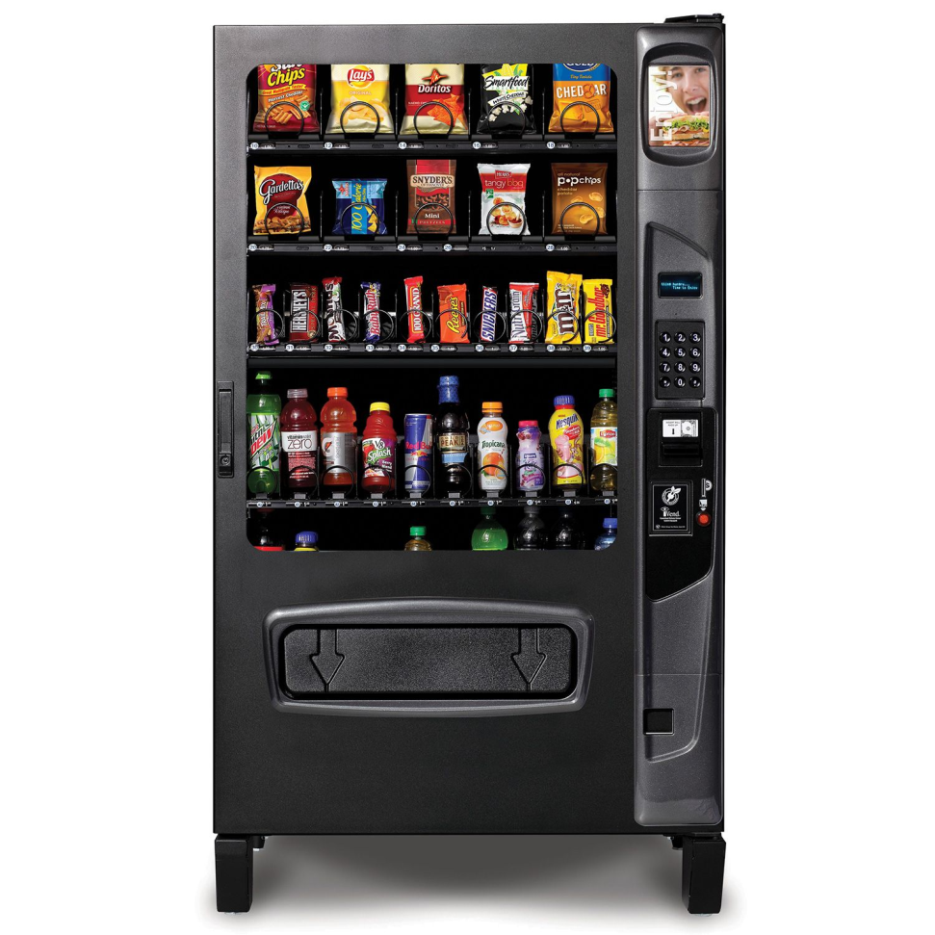
Command Pattern
Vending Machine
Many different unique choices.
Same action.
How would we construct this in our software design?
How do we design flexibility?

Slide 29
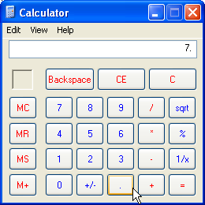
Command Pattern
Pattern Classification:
Behavioral Pattern
Problem:
Need to issue requests to objects without knowing anything about the operation being requested or the receiver of the request.
Solution:
Encapsulate request to the receiving object in command objects, and provide these objects with a common interface to execute the requests they represent.

Slide 30
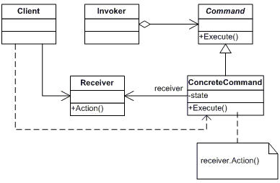
Command Pattern

Slide 31
Command Pattern
Client
Creates a ConcreteCommand object and sets its receiver.
Receiver
Is responsible for knowing how/when to perform the actions.
Invoker
Requests that the Command carries out a specific task.
Command
Serves as an interface for access to the execution of an operation.

Slide 32
Command Pattern
Command Objects
Know what to do.
Invoker Objects
Know when to do commands.
“Encapsulate a request as an object, thereby letting you parameterize clients with different requests, queue or log requests, and support undoable operations.” -GoF

